Slide 1
IBM Watson Data Expert Services Learn Modeler Flow Editor Labs Watson Studio

Slide 2
SPSS Visual Model Lab
10
01

Slide 3
CONTENT
Data Understanding
-Modeler Interface -Reading Data Files -Type Node -Audit Node : Field Distributions and Summary Statistics
Outliers and Anomalous data
Data Manipulation
Relationship in Data
Combine Data Files
Aggregating Data
Selecting, Sampling and Partitioning Records
Modeling Techniques in Modeler

Slide 4
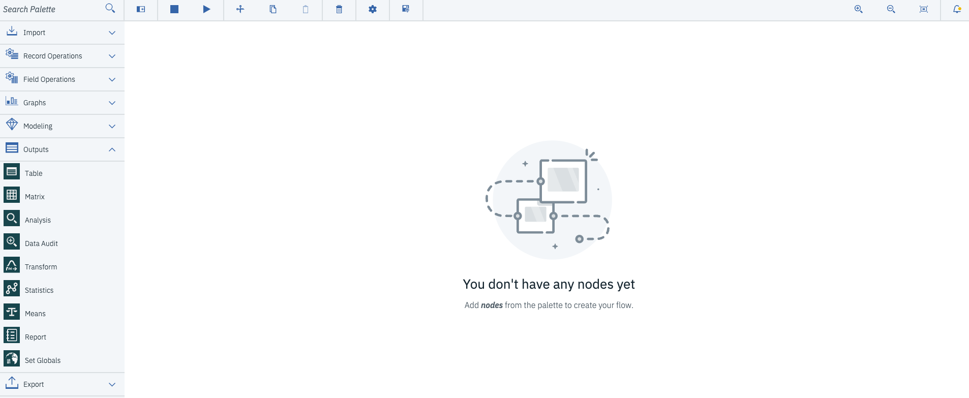
Modeler User Interface
1. Placing a node
2. Moving a Node
3. Editing a Node (double click)
4. Renaming and Annotating a Node
5. Copy and Past a Node
6. Deleting a node
7. Connecting Nodes
8. Disconnecting Nodes
Palettes
Stream Canvas
Nodes

Slide 5
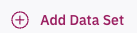
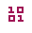
QUICK EXERCISE
Create project ‘test’
Add dataset SmallSampleMissing.csv
Start Modeler, with ‘XploreaSpss’
Familiarize yourself with Modeler environment:
Placing a node on the stream canvas
Moving a Node
Editing a Node (double click)
Renaming and Annotating a Node
Copy and Past a Node
Deleting a node
Connecting Nodes
Disconnecting Nodes
Select the file to select data you have added in Dataset
Select the table node from the output palette and place it next to the DataAsset node.
Preview data on the DataAsset node (create a chart and save)
Run the stream and View file generated in Ouputs
Connect these two nodes
Disconnect the two nodes.
Delete one of the nodes in the stream. (shift and select)
Exit Modeler without saving the stream.

Slide 6
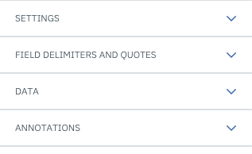
Reading Data files (double click)
SETTINGS
Read field names from file
Selected by default, this option treats the first row in the data file as labels for the column. If your first row is not a header, deselect to automatically give each field a generic name, such as Field1, Field2, for the number of fields in the dataset.
Specify number of fields.
Specify the number of fields in each record. The number of fields can be detected automatically as long as the records are new-line terminated. You can also set a number manually.
Skip header characters.
Specify how many characters you want to ignore at the beginning of the first record.
EOL comment characters.
Specify characters, such as # or !, to indicate annotations in the data. Wherever one of these characters appears in the data file, everything up to but not including the next new-line character will be ignored.
Strip lead and trail spaces.
Select options for discarding leading and trailing spaces in strings on import.
he specified symbol (one character only). Invalid characters are null characters or any character that does not exist in the encoding method specified.
Encoding.
Specifies the text-encoding method used. You can choose between the system default, stream default, or UTF-8.
The system default is specified in the Windows Control Panel or, if running in distributed mode, on the server computer.
The stream default is specified in the Stream Properties dialog box.
Decimal symbol
Select the type of decimal separator that is used in your data source. The Stream default is the character that is selected from the Options tab of the stream properties dialog box. Otherwise, select either Period (.) or Comma (,) to read all data in this dialog box using the chosen character as the decimal separator.
Line delimiter is newline character
To use the newline character as the line delimiter, instead of a field delimiter, select this option. For example, this may be useful if there is an odd number of delimiters in a row that cause the line to wrap. Note that selecting this option means you cannot select Newline in the Delimiters list.
Delimiters.
Using the check boxes listed for this control, you can specify which characters, such as the comma (,), define field boundaries in the file. You can also specify more than one delimiter, such as ", |" for records that use multiple delimiters. The default delimiter is the comma.
Lines to scan for column and type
Specify how many lines and columns to scan for specified data types.
Automatically recognize dates and times
To enable IBM® SPSS® Modeler to automatically attempt to recognize data entries as dates or times, select this check box. For example, this means that an entry such as 07-11-1965 will be identified as a date and 02:35:58 will be identified as a time; however, ambiguous entries such as 07111965 or 023558 will show up as integers since there are no delimiters between the numbers.
Treat square brackets as lists If you select this check box, the data included between opening and closing square brackets is treated as a single value, even if the content includes delimiter characters such as commas and double quotes. For example, this might include two or three dimensional geospatial data, where the coordinates contained within square brackets are processed as a single list item.

Slide 7
Reading Data files
SETTINGS
Read field names from file
Selected by default, this option treats the first row in the data file as labels for the column. If your first row is not a header, deselect to automatically give each field a generic name, such as Field1, Field2, for the number of fields in the dataset.
Specify number of fields.
Specify the number of fields in each record. The number of fields can be detected automatically as long as the records are new-line terminated. You can also set a number manually.
Skip header characters.
Specify how many characters you want to ignore at the beginning of the first record.
EOL comment characters.
Specify characters, such as # or !, to indicate annotations in the data. Wherever one of these characters appears in the data file, everything up to but not including the next new-line character will be ignored.
Strip lead and trail spaces.
Select options for discarding leading and trailing spaces in strings on import.
he specified symbol (one character only). Invalid characters are null characters or any character that does not exist in the encoding method specified.
Encoding.
Specifies the text-encoding method used. You can choose between the system default, stream default, or UTF-8.
The system default is specified in the Windows Control Panel or, if running in distributed mode, on the server computer.
The stream default is specified in the Stream Properties dialog box.
Decimal symbol
Select the type of decimal separator that is used in your data source. The Stream default is the character that is selected from the Options tab of the stream properties dialog box. Otherwise, select either Period (.) or Comma (,) to read all data in this dialog box using the chosen character as the decimal separator.
Line delimiter is newline character
To use the newline character as the line delimiter, instead of a field delimiter, select this option. For example, this may be useful if there is an odd number of delimiters in a row that cause the line to wrap. Note that selecting this option means you cannot select Newline in the Delimiters list.
Delimiters.
Using the check boxes listed for this control, you can specify which characters, such as the comma (,), define field boundaries in the file. You can also specify more than one delimiter, such as ", |" for records that use multiple delimiters. The default delimiter is the comma.
Lines to scan for column and type
Specify how many lines and columns to scan for specified data types.
Automatically recognize dates and times
To enable IBM® SPSS® Modeler to automatically attempt to recognize data entries as dates or times, select this check box. For example, this means that an entry such as 07-11-1965 will be identified as a date and 02:35:58 will be identified as a time; however, ambiguous entries such as 07111965 or 023558 will show up as integers since there are no delimiters between the numbers.
Treat square brackets as lists If you select this check box, the data included between opening and closing square brackets is treated as a single value, even if the content includes delimiter characters such as commas and double quotes. For example, this might include two or three dimensional geospatial data, where the coordinates contained within square brackets are processed as a single list item.

Slide 8
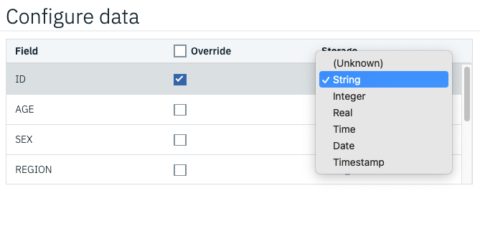
Reading Data files
FIELD DELIMITERS AND QUOTES
Quotes. Using the drop-down lists, you can specify how single and double quotation marks are treated on import. You can choose to Discardall quotation marks, Include as text by including them in the field value, or Pair and discard to match pairs of quotation marks and remove them. If a quotation mark is unmatched, you will receive an error message. Both Discard and Pair and discard store the field value (without quotation marks) as a string..

Slide 9
Type Node
Field properties can be specified Type node.
Specifying a usage type, such as range, set, ordered set, or flag, for each field in your dataset.
Setting options for handling missing values and system nulls.
Setting the role of a field for modeling purposes.
Specifying values for a field as well as options used to automatically read values from the dataset.
Specifying field and value labels.
Measurement Level Definition
Continuous | Used to describe numeric values. A continuous value may be an integer, real number or data/time.
Categorical | Used for string values when an exact number of distinct values is unknown
Flag | Used for data with two distinct values such as Yes/No or 1/2
Nominal | Used to describe data with multiple distinct values, each treated as a member of a set, such as married, single, divorced.
Ordinal | Used to describe data with multiple distinct values that have an inherent order, such as 1 low, 2 medium and 3 high.

Slide 10
Value mode
Value Mode | Function
<Read> | Data is read when the node is executed.
<Pass> | No data is read.
<Current> | Keep current data values.
Specify... | A separate dialog box opens for you to specify values and measurement level options
Checking type values
Turning on the Check option for each field examines all values in that field to determine whether they comply with the current type settings or the values that you've specified
None. | Values will be passed through without checking. This is the default setting.
Nullify. | Change values outside of the limits to the system null ($null$).
Coerce. | Fields whose measurement levels are fully instantiated will be checked for values that fall outside the specified ranges. Unspecified values will be converted to a legal value for that measurement level using the following rules: For flags, any value other than the true and false value is converted to the false value For sets (nominal or ordinal), any unknown value is converted to the first member of the set's values Numbers greater than the upper limit of a range are replaced by the upper limit Numbers less than the lower limit of a range are replaced by the lower limit Null values in a range are given the midpoint value for that range
Discard. | When illegal values are found, the entire record is discarded.
Warn. | The number of illegal items is counted and reported in the flow properties dialog when all of the data has been read.
Abort. | The first illegal value encountered terminates the running of the flow. The error is reported in the flow properties dialog.

Slide 11
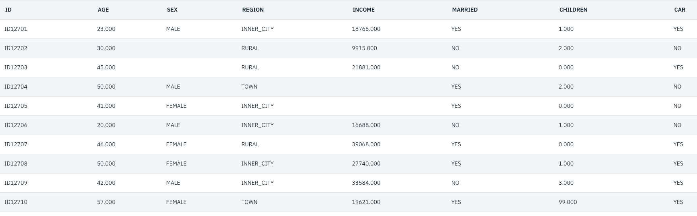
QUICK EXERCISE
Take a look of SmallSampleMissing.csv
Data table showing blanks and missing values

Slide 12
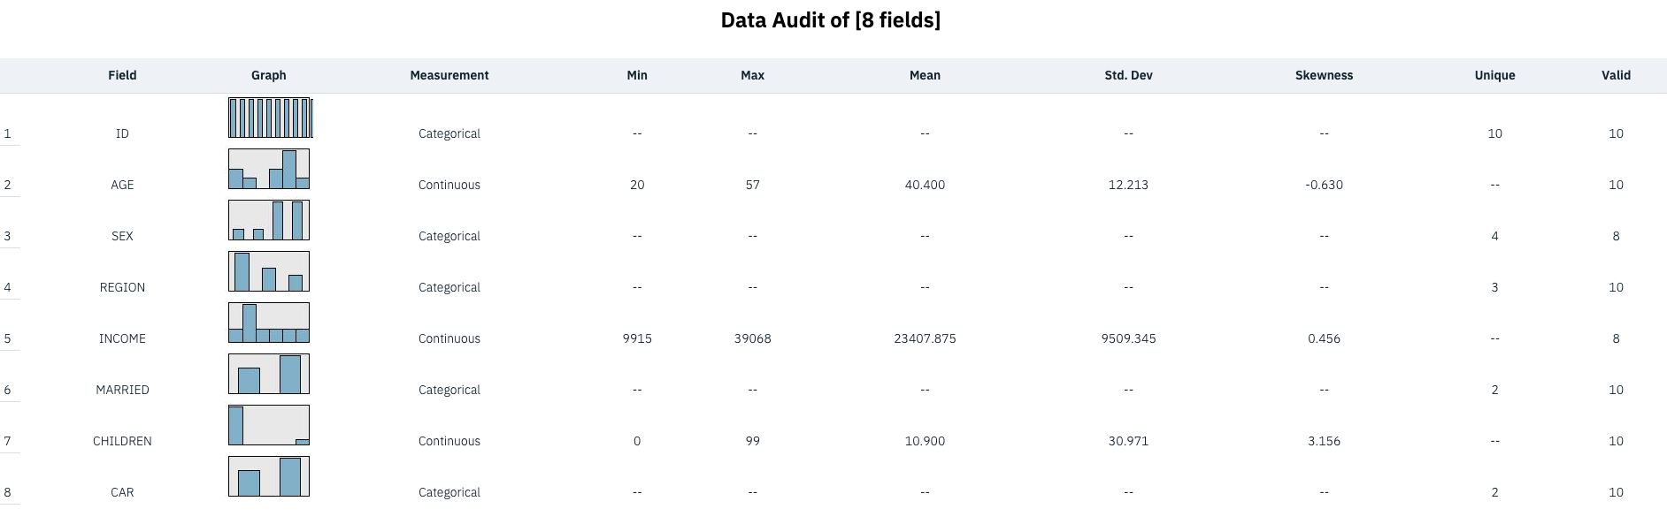
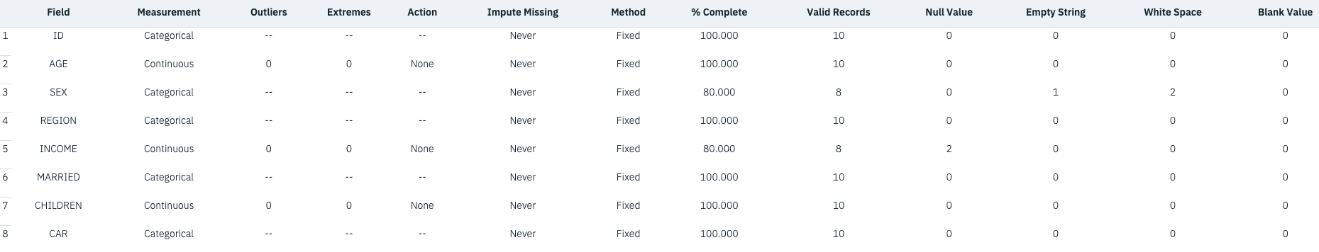
Data audit
Categorical
Unique, Valid data
Bar chart
Continuous –
Min, max Mean, Std. Dev Skewness, valid
Histogram
Type of missing data | Definition
$Null$ value | Applies only to numeric fields. This is a cell that is empty or has an illegal value
White space | Applies only to string/categorical fields. This is a cell that is empty or has spaces.
Empty string | Applies only to string/categorical fields. This is a cell that is empty. Empty string is a subset of white space
Blank value | This is predefined code, and it applies to any type of field

Slide 13
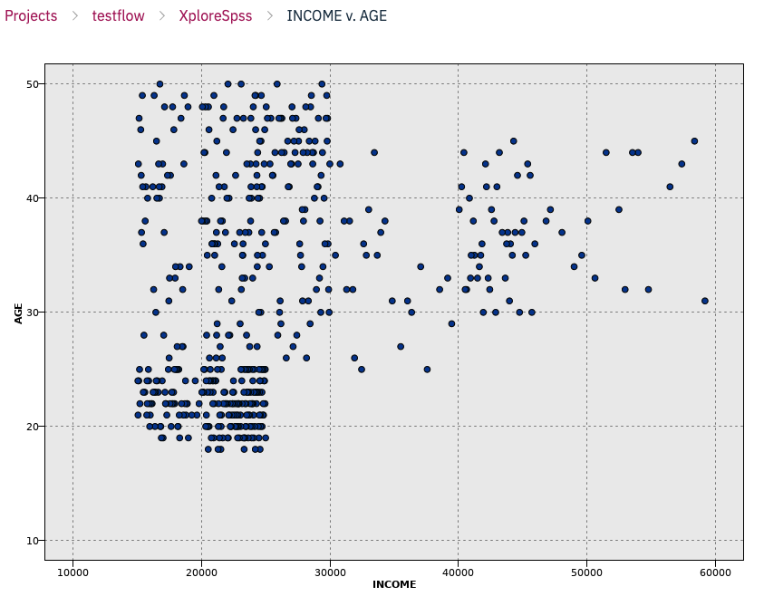
Graph
Multiplot node A multiplot is a special type of plot that displays multiple Y fields over a single X field. The Y fields are plotted as colored lines and each is equivalent to a Plot node with Style set to Line and X Mode set to Sort. Multiplots are useful when you have time sequence data and want to explore the fluctuation of several variables over time.
Time Plot node Time Plot nodes allow you to view one or more time series plotted over time. The series you plot must contain numeric values and are assumed to occur over a range of time in which the periods are uniform.
Distribution node A distribution graph or table shows the occurrence of symbolic (non-numeric) values, such as mortgage type or gender, in a dataset. A typical use of the Distribution node is to show imbalances in the data that can be rectified by using a Balance node before creating a model. You can automatically generate a Balance node using the Generate menu in the distribution graph or table window.
Histogram node Histogram nodes show the occurrence of values for numeric fields. They are often used to explore the data before manipulations and model building. Similar to the Distribution node, Histogram nodes are frequently used to reveal imbalances in the data.
Collection node Collections are similar to histograms, but collections show the distribution of values for one numeric field relative to the values of another, rather than the occurrence of values for a single field. A collection is useful for illustrating a variable or field whose values change over time.
Web node Web nodes show the strength of relationships between values of two or more symbolic fields. The graph displays connections using varying types of lines to indicate connection strength. You can use a Web node, for example, to explore the relationship between the purchase of various items at an e-commerce site or a traditional retail outlet.
Evaluation node The Evaluation node offers an easy way to evaluate and compare predictive models to choose the best model for your application. Evaluation charts show how models perform in predicting particular outcomes. They work by sorting records based on the predicted value and confidence of the prediction, splitting the records into groups of equal size (quantiles), and then plotting the value of the business criterion for each quantile, from highest to lowest. Multiple models are shown as separate lines in the plot
Plot node Plot nodes show the relationship between numeric fields. You can create a plot using points (also known as a scatterplot), or you can use lines. You can create three types of line plots by specifying an X Mode in the node properties.

Slide 14
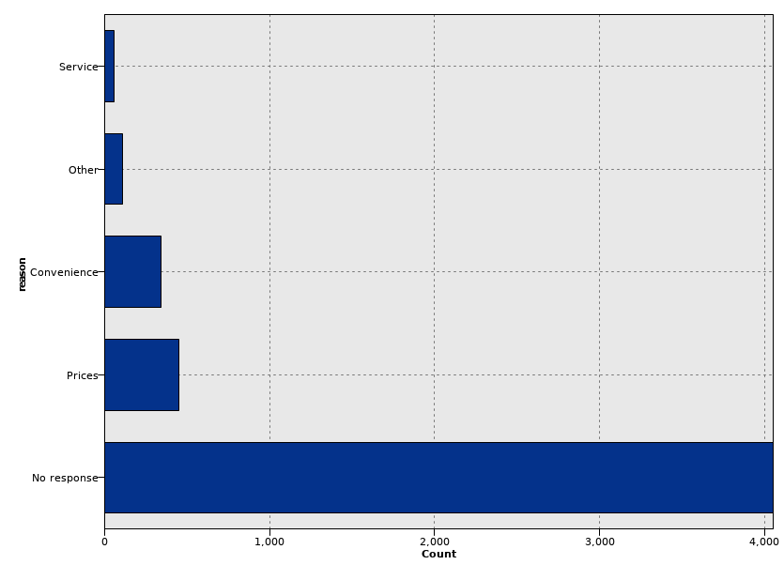
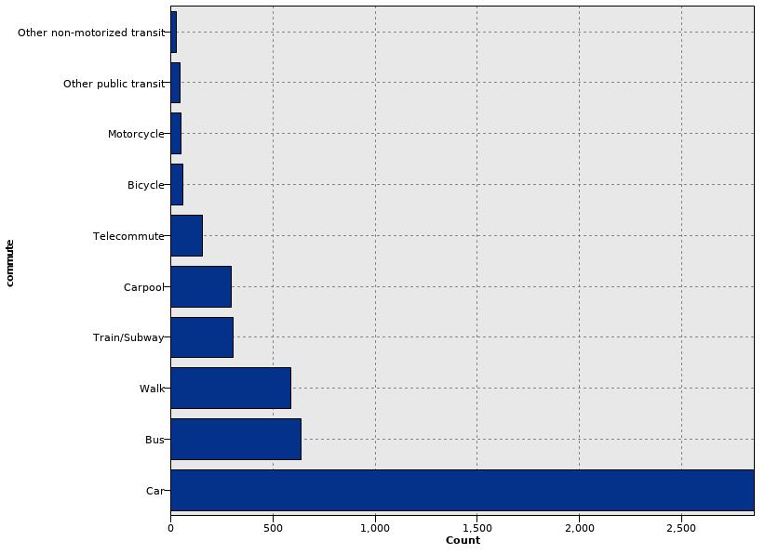
Outliers and Anomalous Data (Data: Customer_offers.sav)
What is Anomalous data
Far from the center of the distribution, measured by the mean or median and using the standard deviation as a measure of spread;
Far from other values
Outliers in Categorical Fields
Adjusting this type of outlier means either:
Grouping categories together
Remove these categories from the stream
Why so many no response?
Don’t have opinion or refuse to answer?
No-Response==Missing Data OR No Response==Don’t know

Slide 15
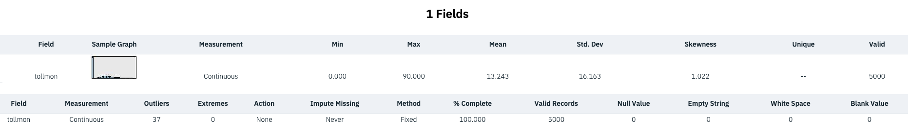
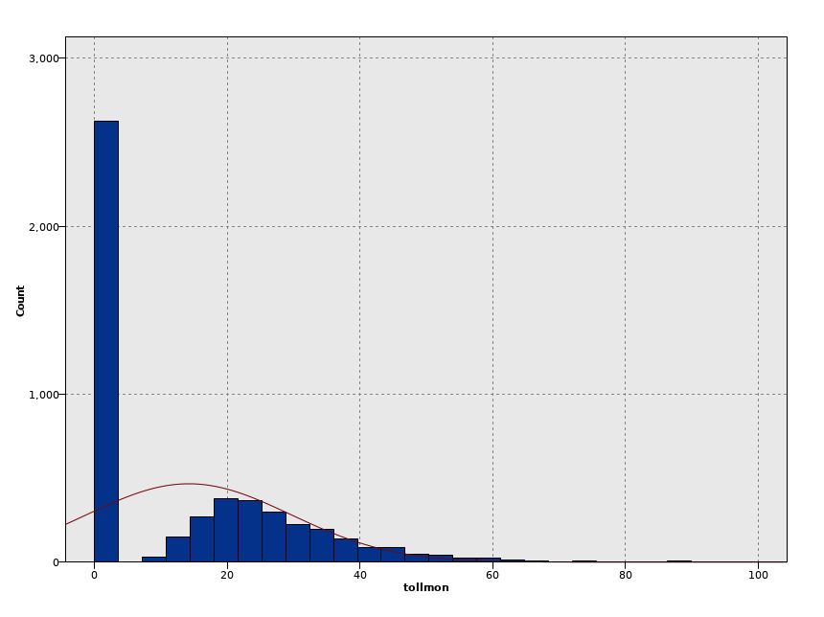
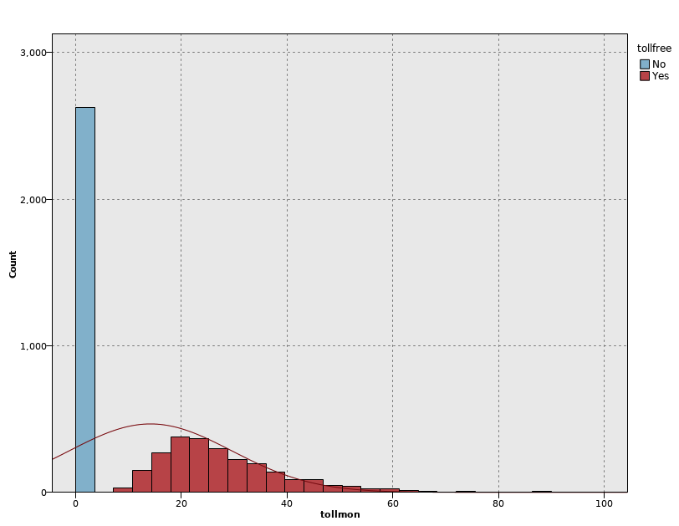
Outliers in Continuous Fields
Given Min: 0, max 90, it doesn’t seem too great a range. But the mean is about 13.24 with standard deviation of 16.16.
It means customers who used over 60 minutes are quite statistically unusual because they are several standard deviations above the mean.
Two concerns
Over half of the customers have value of 0
Extreme records.
Investigate if tollmon=0 has toll free service

Slide 16
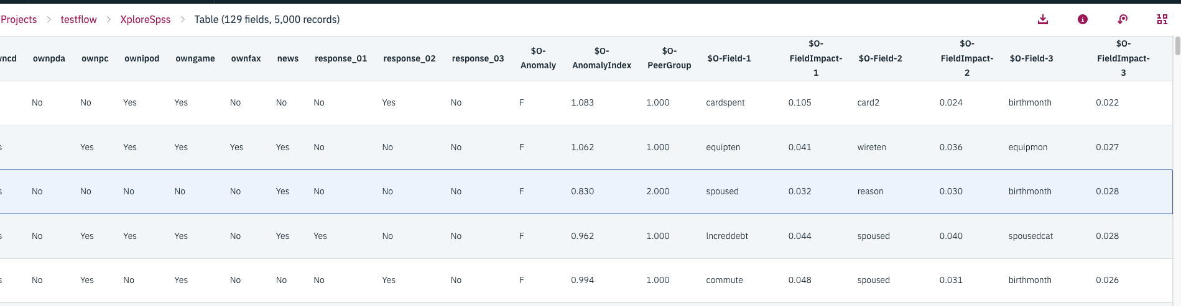
The Anomaly Node
$0-Anomaly is flag field identifying anomalous records
$0-AnnomalyIndex anomaly index value
Next set of columns lists the specific fields on which a case was anomalous and the impact of that field’s value on anomaly index

Slide 17
Data Manipulation
Several field options: Filter, Field Reorder, Derive and Reclassify
Data Transformations
Automatically generate field operation nodes
Data : Risk.csv

Slide 18
In the Data Preparation phase of the CRISP-DM process, you construct the final dataset for modeling. This involves a variety of potential activities, including creating new fields or transforming existing ones, selecting groups of records or sampling from a larger data file, and cleaning data based on checks on data quality.
Techniques to modify and prepare data can be found in either the Record Ops palette ( containing tools for manipulating records) or Field Ops palette ( containing tools for manipulating fields).
In this lesson we introduce several field operation nodes, including the
Filter node, which removes unwanted fields from analysis;
Reorder node, which reorders fields in the data stream and dialogs;
Derive node, used to create new fields in the data stream;
Reclassify node, which is used to change the coding of or collapse categories for categorical fields.

Slide 19
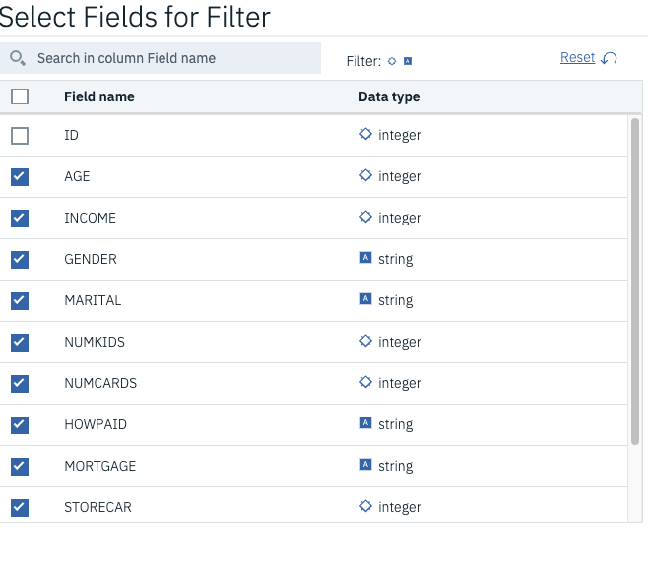
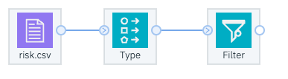
Filter
Filter node that can rename fields and remove unwanted fields from the data stream.
When data mining, two potential problems may occur within a field:
A large proportion of missing records
All (or almost all) records having the same value (invariant
The Filter node ( or Filter tab of a source node) allows data to pass through it and has two main functions:
To filter out (discard) unwanted fields
To rename fields

Slide 20
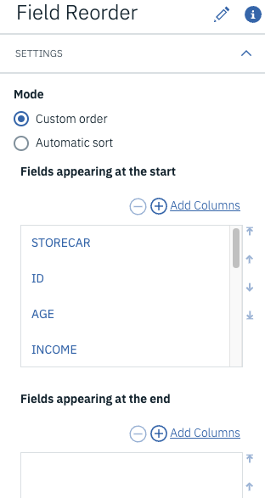
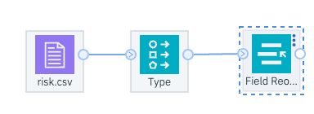
Field Reordering
Another useful field operation is to reorder the fields, which would affect their ordering in dialog boxes and data streams. For example, you might want a specific field ordering in a table to better compare the outcome with predictions from different models, or it might be easier to locate field names in dialogs if they were alphabetically ordered.
The Field Reorder node will reorder fields downstream of the node

Slide 21
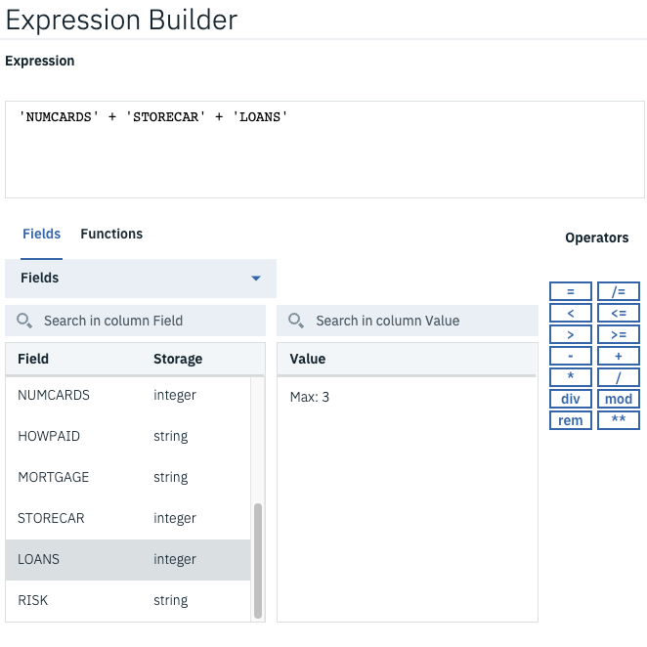
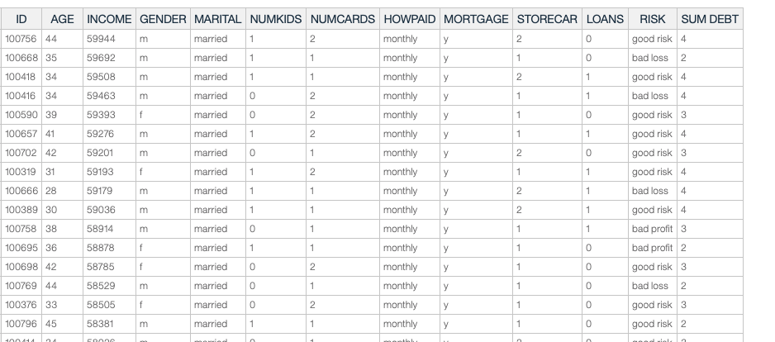
Derive Node
It will invariably be necessary to modify data values or create new fields as functions of others.
The Derive node calculates a new value based on a expression for every record passed through it.
3. Derive a field with Name: SUM DEBT; with sum of NUMCARDS + STORECARDS + LOANS

Slide 22
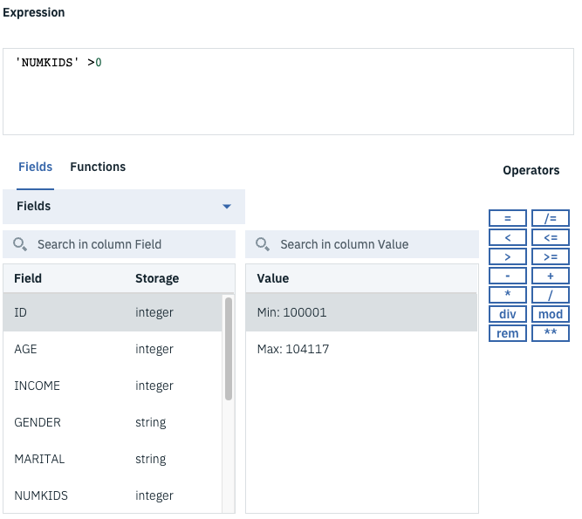
Quick exercise (Flag)2
1. Create a new field, CHILDREN, which is True if the number of children field (NUMKIDS) is greater than zero, and False if not.

Slide 23
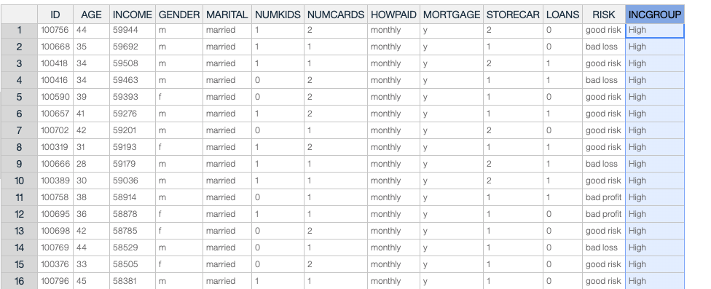
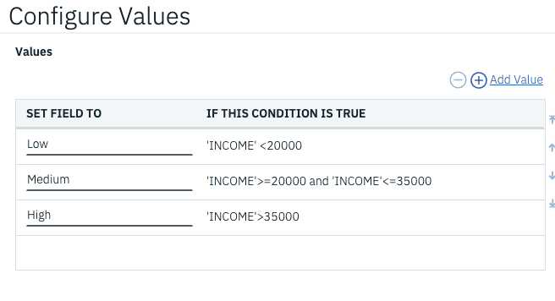
Quick Exercise (Nominal) 3
we will create a new field called INCGROUP, which is the INCOME field banded into 3 bands:
Under 20,000
20,000 to 35,000
Over 35,000

Slide 24
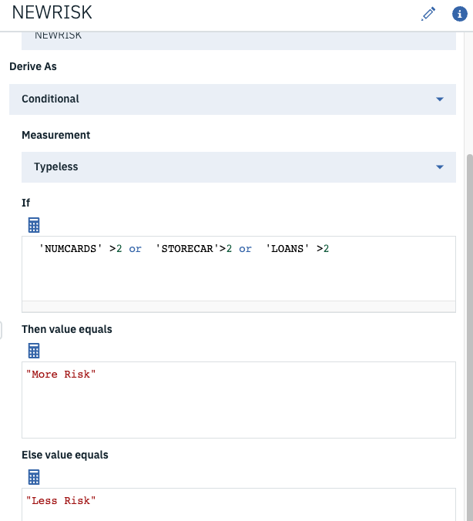
Quick Exercise (Conditional) 4
Derive node we will create a new field called NEWRISK that will be another measure of the risk of offering credit to a consumer based on three of the existing fields: NUMCARDS, STORECARDS, and LOAN.
Basically, those consumers with lower values on these three fields will be in one category, and any high value will place someone in the more risky category.
You may use this as reference: NUMCARDS > 2 or STORECARDS > 2 or LOANS > 1

Slide 25
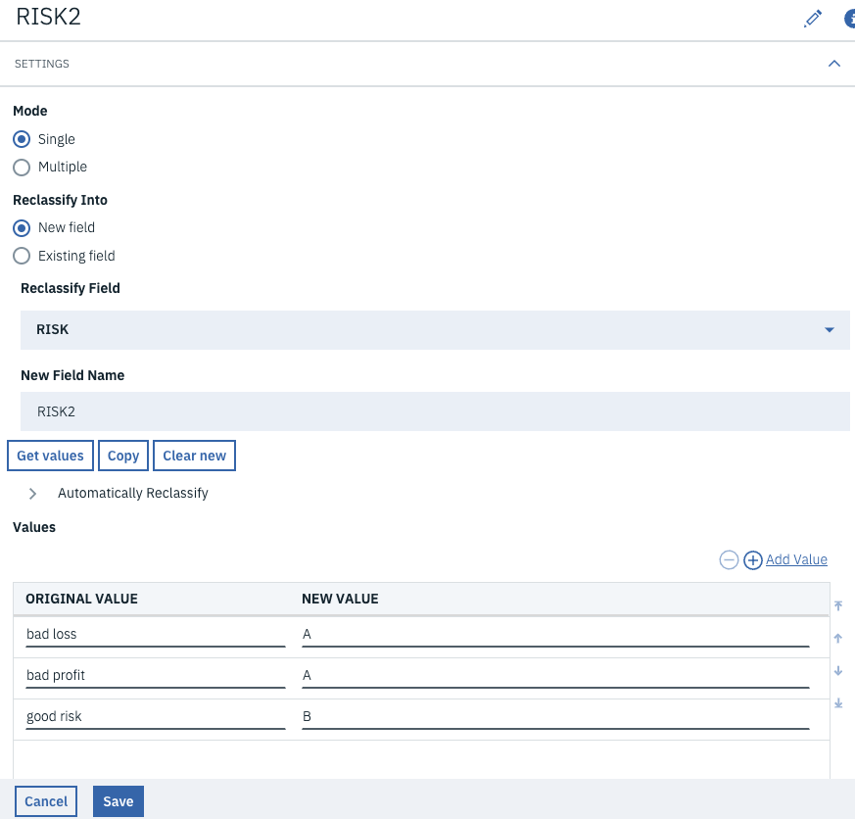
Reclassify Node
The Reclassify node allows you to reclassify, or recode, the data values for categorical fields.
For example, a field that stores a customer's specific job position may be more useful for prediction if it is reclassified into broader job categories.

Slide 26
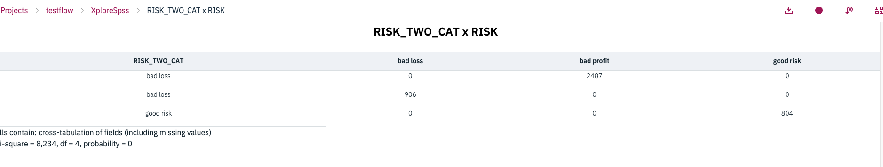
Matrix Node
It is good practice to always check the new created fields
• For fields created from formulas, you might simply review the output from a Table node and calculate a few values yourself to check the equation
• For fields created with logical conditions from other fields, or from the Reclassify node, you might use the Matrix node as a check
Example:
SUM_DEBT – from output table
RISK_TWO_CAT – from matrix node

Slide 27
Exercise
Read data from charity.csv
Connect a Filter node Edit the Filter node to filter out the field TITLE and rename the SEX field to GENDER (Remember: Case counts!). Rename any other field of your choice. Run the Table node to see the changes.
3. Connect a Field Reorder node between the Filter node and the Table node. Move the fields AGE, AGEBAND, and GENDER to the beginning of the file. Run the Table node to see the results of the Filter and Field Reorder nodes.
4. Remove the Filter node, Field Reorder node, and Table node.
5. Use Derive nodes to create two new fields, PreSpend per Visit and PostSpend per Visit as a ratio of the appropriate fields. Use the Expression Builder and check the formulas in the dialog boxes.
6. Use a Reclassify node to create a field named Title_ Gender, which is coded Male or Female based on the values in the Title field.
7. Connect a Table node after the Reclassify node and run to see the results. Further check the results using the Matrix node (Output palette) or Distribution node (Graphs palette) for the Title_ Gender field and the Statistics node (Output palette) for the derived fields. What do you note about the number of cases in the two derived fields? Can you explain the missing cases?
8. Create a histogram of the field called TOTSPEND (Total Spend).

Slide 28
Looking for relationships in Data
Introduce the Web and Matrix nodes to investigate relationships between categorical fields
Illustrate the use of correlation within the statistics node to investigate relationships between continuous fields
Example:
Is credit risk directly related to income?
Do males differ from females with respect to credit risk?
If an individual has a large number of current credit cards, loans, and store cards, does this mean that he is more likely, or less likely, to be a bad credit risk?

Slide 29
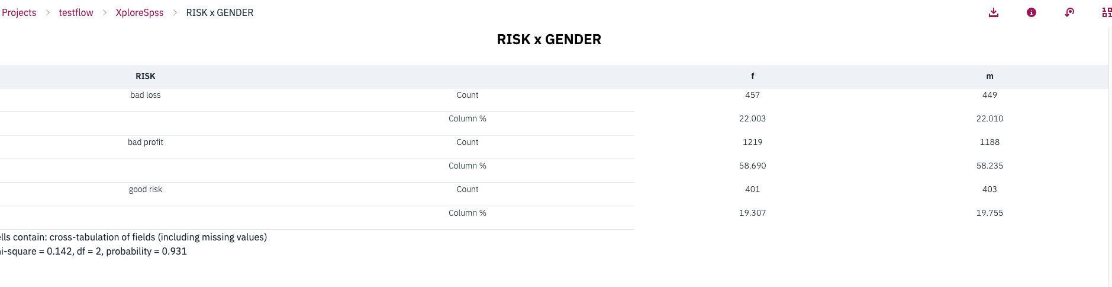
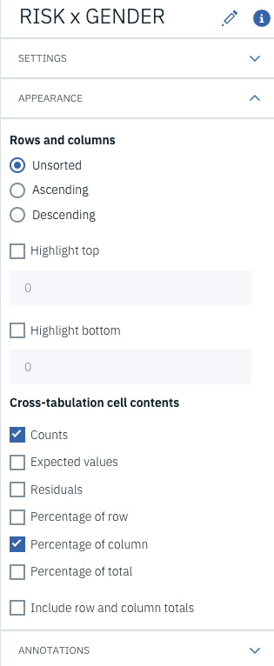
Relating two categorical field (Matrix Node)
Matrix Node

Slide 30
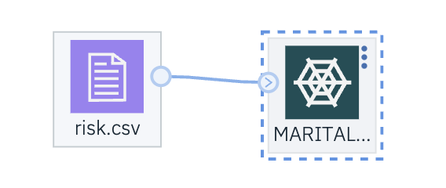
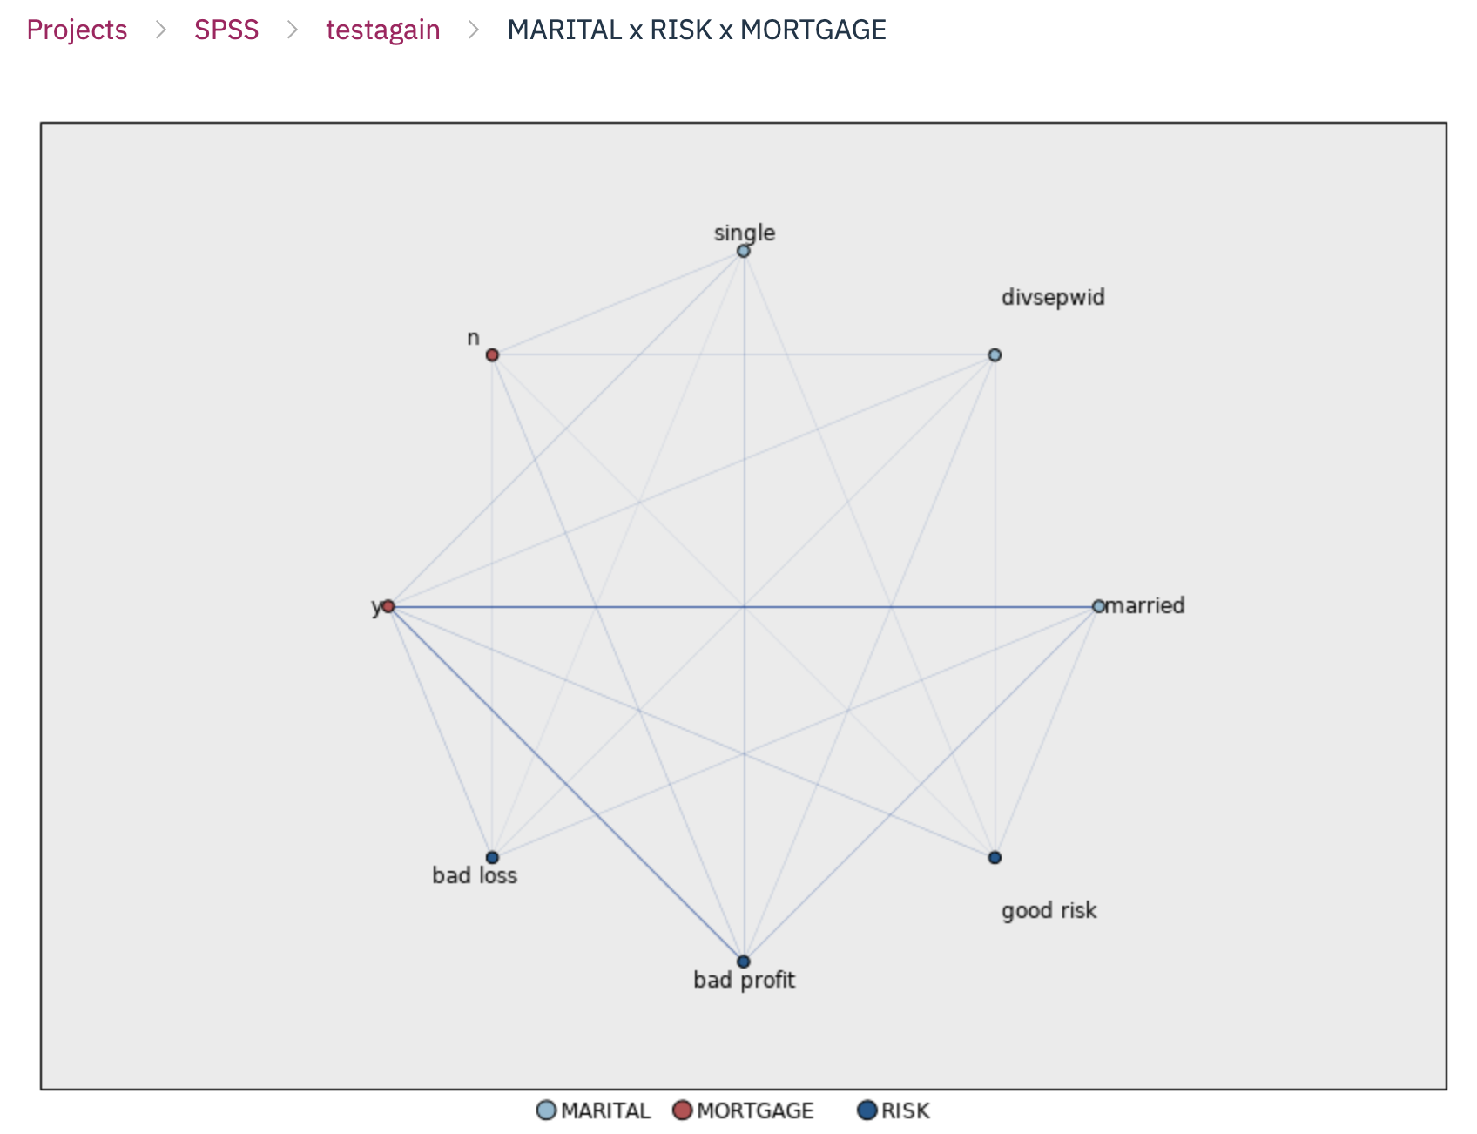
Relating two categorical field (Web Node)
It shows the strength of connection between values of two or more categorical fields
A web plot consists of points representing the values of the selected categorical fields. These points are connected with lines whose thickness depicts the strength of the connections between the values (number ofrecords with both categorical values). Lines thus represent the cells of a matrix table.

Slide 31
Correlations between Continuous Fields
When investigating relationships between continuous fields, a linear correlation is commonly used.
It measures the extent to which two continuous fields are linearly associated.
The correlation value ranges from -1 to + 1, where + 1 represents a perfect positive linear relationship ( as one field increases the other field also increases at a constant rate) and -1 represents a perfect negative relationship ( as one field increases the other decreases at a constant rate). A value of zero represents no linear relationship between the two fields.

Slide 32
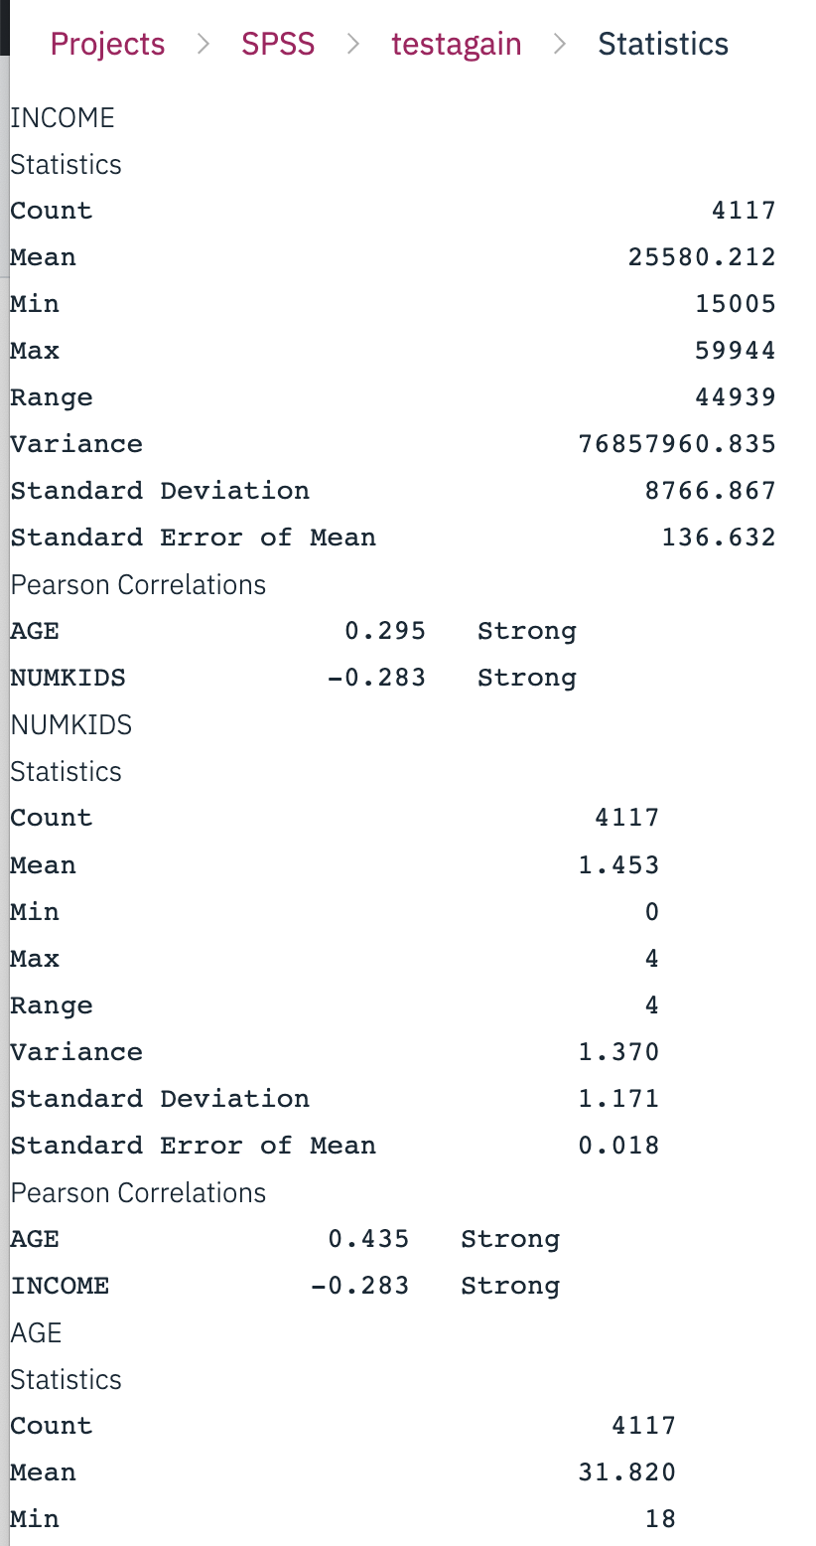
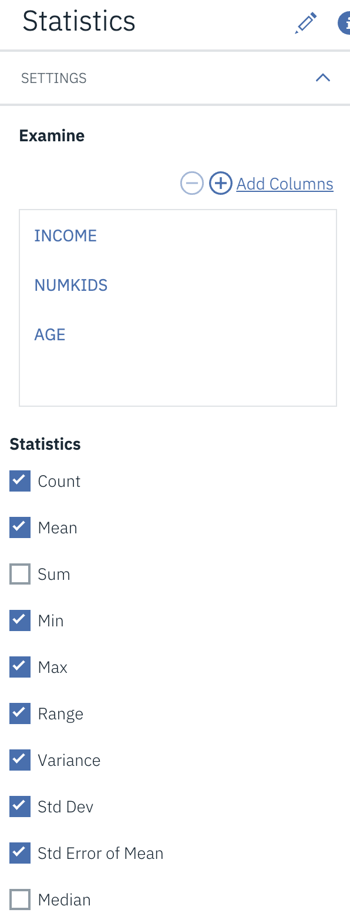
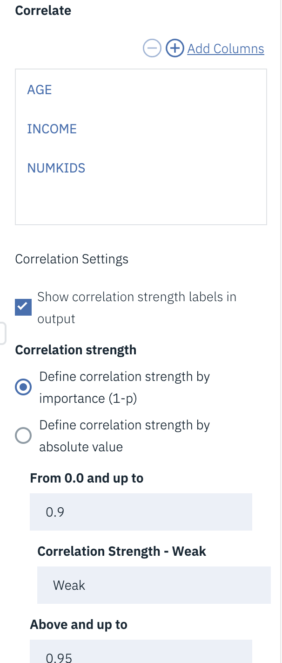
Relating continuous data field (Statistic Node)
Place a Statistics node from the Output palette near the Type node in the Stream Canvas Connect the Type node to the Statistics node
Double-click on the Statistics node

Slide 33
Exercise
In this session we will use the stream created in the previous exercises and investigate whether there are any simple relationships in the data. In future lessons we will attempt to predict the field Response to campaign, and so we will focus on relationships between this field and others in the data.
1.Import data from charity.csv(Read names and labels; Read labels as data)
2.Connect a Matrix node from the Output palette to the source file node. We'll use this node to look at the relationship between RESPONSE andAGEBAND. Place RESPONSE in the row and A GEBAND in the column, request counts and column % be displayed in the matrix table. How would you characterize the relationship of these two fields?
3.Connect a Web node from the Graphs palette to the source file node.
4.Edit the Web node to produce a web plot showing the relationships between the following fields:
Response to campaign (RESPONSE); Pre-campaign spend category (SPENDB); Pre-campaign visit category(VISITB); Gender (SEX); Age category (AGEBAND)
5.Due to the substantial number ofrecords in the data, set Show only links above to 200, set Weak links below to 300, and set Strong links above to 400. Run the node.
6.Edit the web plot by hiding irrelevant connections. What are the three strongest connections with the responder value of the response to campaign field? Which age groups are most associated with the non-responders?
7.Next we will investigate the relationship between the continuous fields of ORI SPEND (Pre­campaign expenditure) and ORIVISIT (Pre-campaign visits). Use the Plot node to display a graph of the two fields (ORIVISIT on the X-axis; ORISPEND on the Y-axis) and the Statistics node to request summary statistics and the correlation coefficient. Does there appear to be a relationship in this data between these two fields?
8.Finally, we will investigate whether there is a relationship between the ORISPEND (Pre­campaign expenditure) and the RESPONSE (Response to campaign) field. Use the Means node to display all of the statistics for the Responder and Non-responder groups on pre­campaign expenditure.
9.Use the Graphboard node to create an appropriate graph to study the relationship between the same two fields as in Question 8. Which graph did you select? What is the relationship between the two fields? If so, is this consistent with your previous conclusions?
Add a third field to the graph, such as SEX, using Graphboard to help select the graph. Which graph type did you choose? What is the relationship between these three fields?
Edit one of the graphs you have created above to modify its appearance, including adding a title, changing font type and size for the axes, and the color of the graph elements.
Save a copy of the stream under the name ExerLesson7.str.

Slide 34
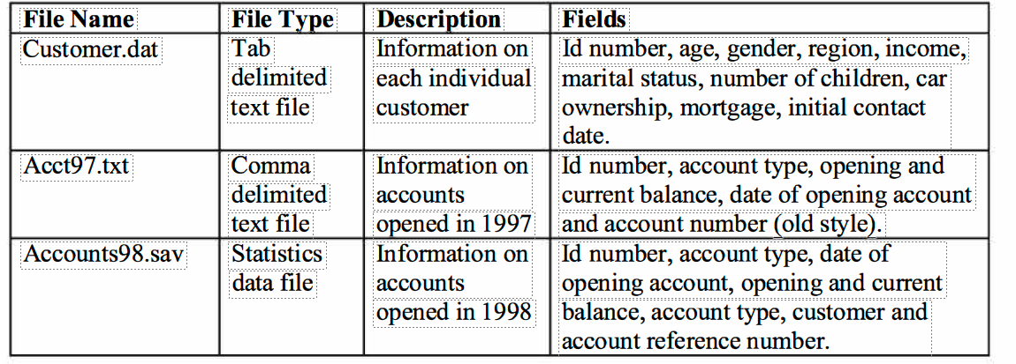
Combining Data Files
• Introduce the Append node as a method of joining sets ofrecords together
• Introduce the Merge node as a method of combining multiple records from two or more files to create a single record
Data

Slide 35
Using the Append Node to Combine Data Files
The Append node joins two or more data sources together so that information held for different groups of records can be analyzed and compared.
When there are different numbers of fields contained within the sources (inputs) the Append node uses the following rules:
If an input has fewer fields than the main dataset, then the records from the input source are padded with the undefined value ($null$) for the missing fields.
If an input has more fields than the main dataset, then the extra fields are, by default, filtered from the stream, but an option allows all fields to be input from all datasets. If fields are input from all datasets, then records from sources not containing these fields are padded with the undefined value ($null$).

Slide 36
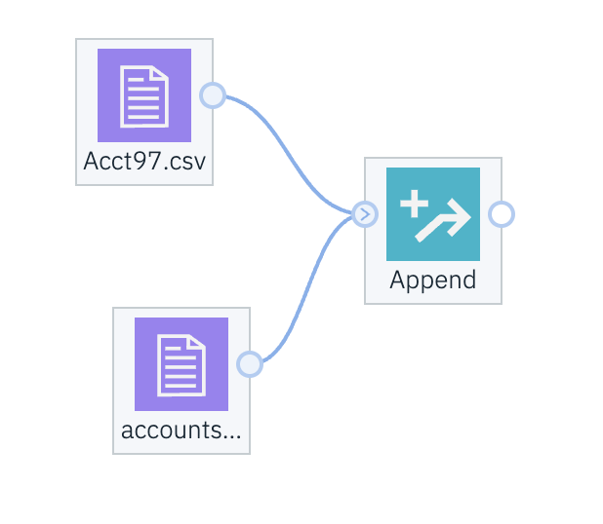
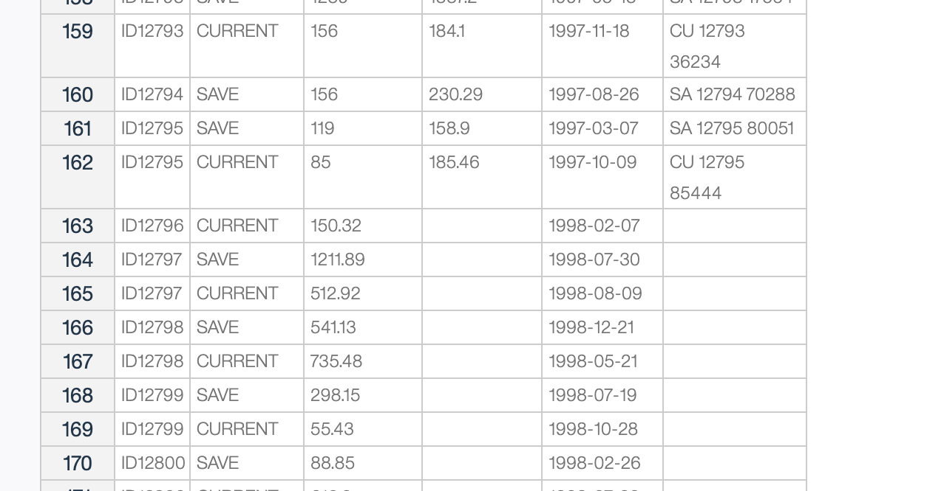
Quick Exercise
1. Append node by using it to join the two files containing information on accounts opened in 1997 and 1998. The files, acct97.csv and accounts98.csv
1997
1998

Slide 37
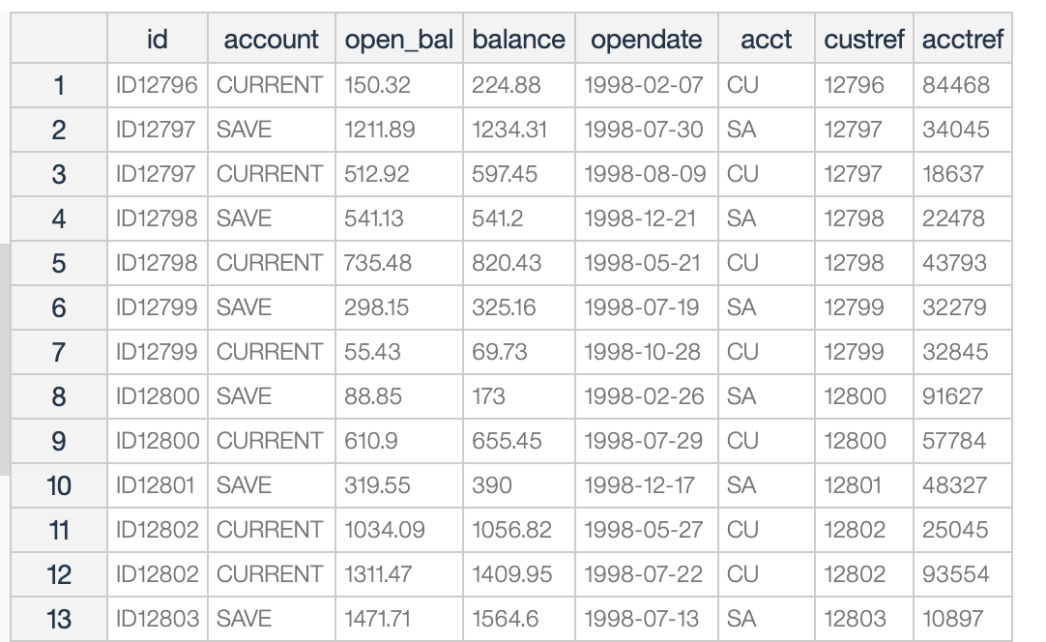
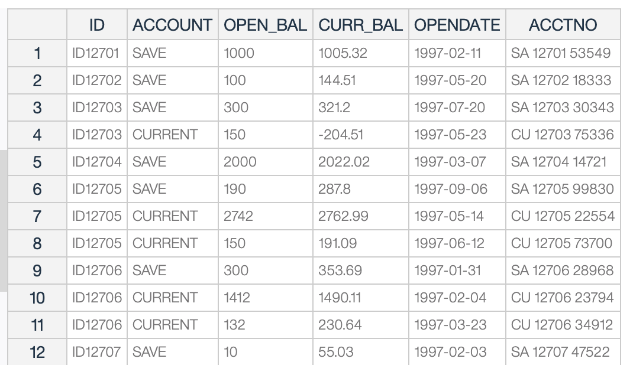
1. Derive ACCT from ACCTNO
2. Add a Derive node to create the CUSTREF field, using the substring function on ACCT,
now beginning in 1 with length 2. The formula is substring(1, 2, ACCTNO)
2. Add a Derive node to create the CUSTREF field, using the substring function on ACCTNO,
now beginning in 4 with length 5. The formula is substring(4, 5, ACCTNO)
3. Add a Derive node to create the ACCTREF field, again taking a substring on ACCTNO, this time beginning in 10 with length 5. The formula is substring(10,5,ACCTNO)

Slide 38
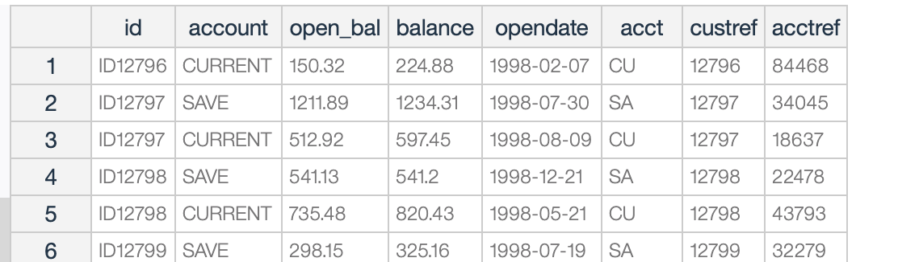
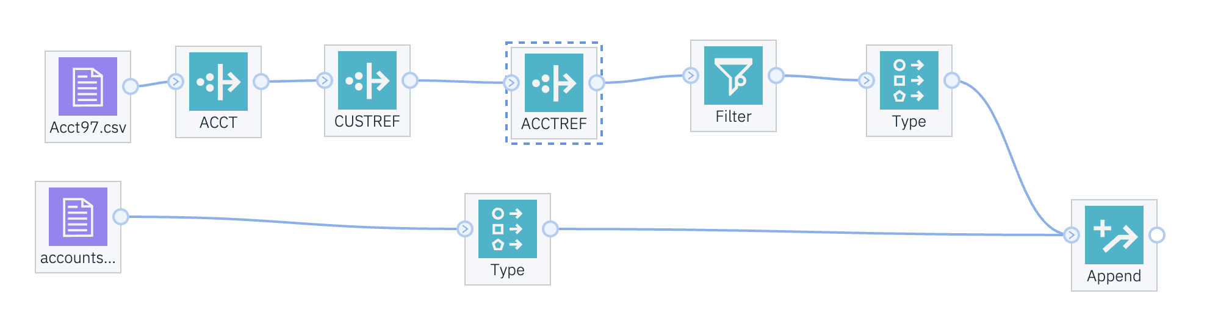
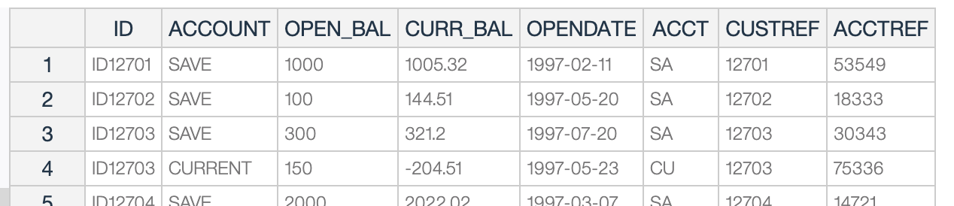
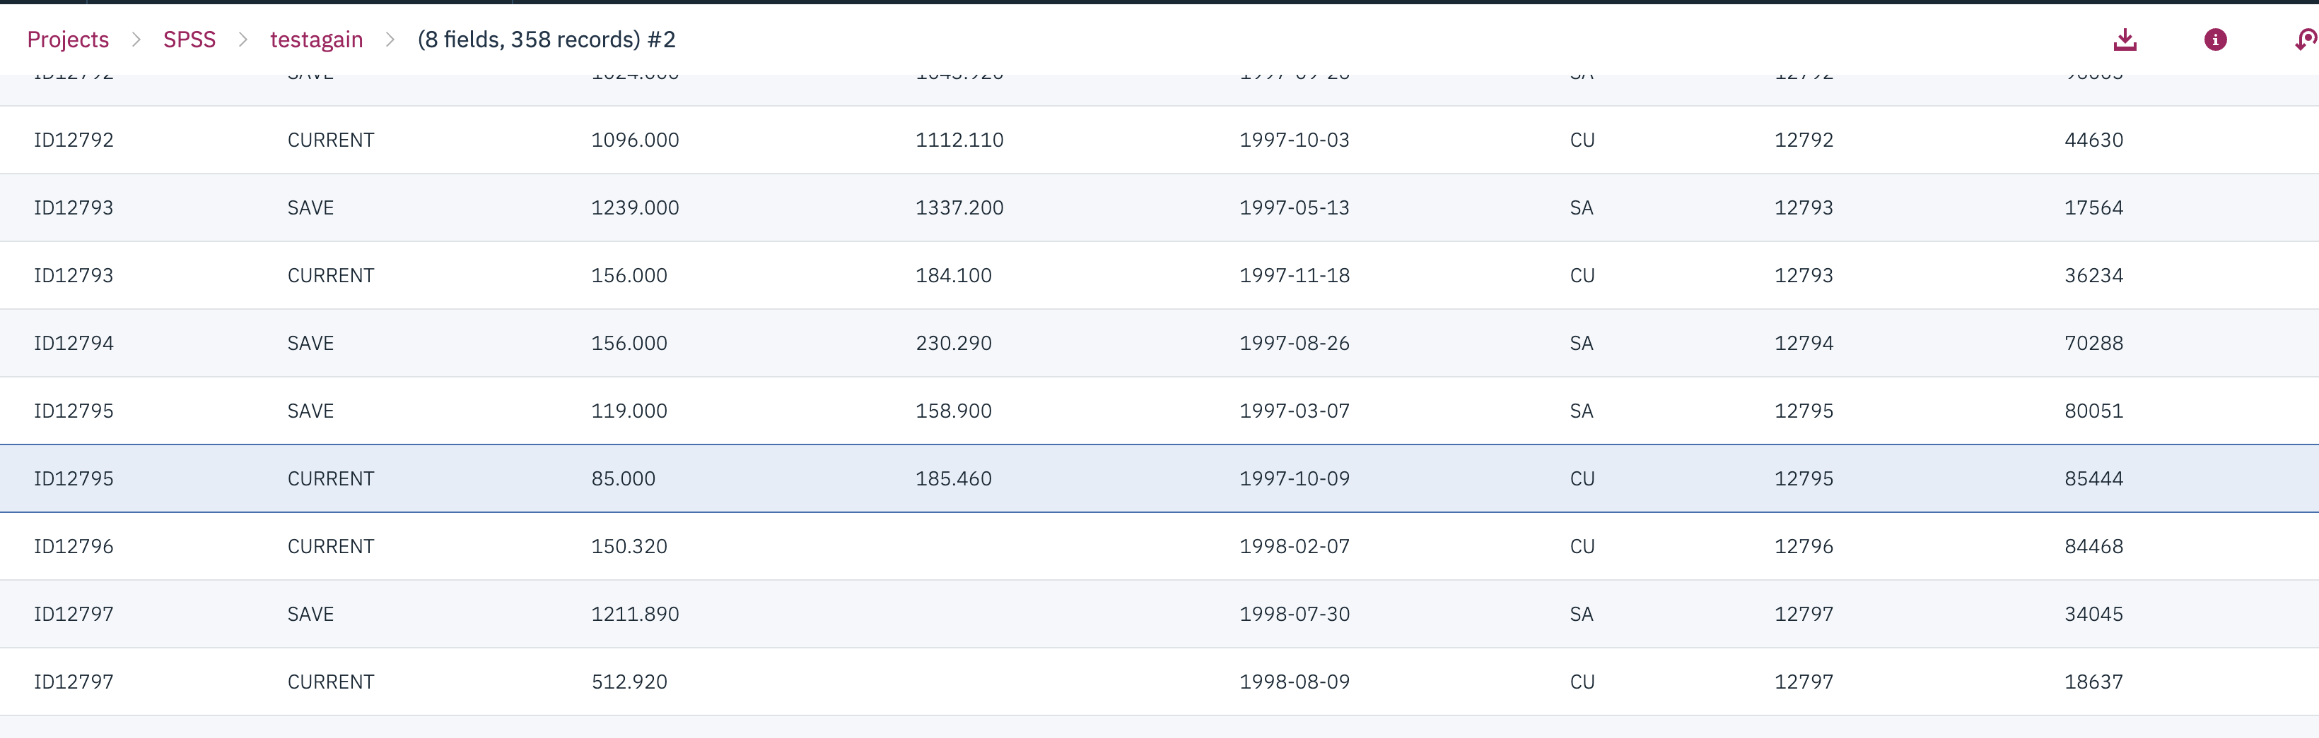
Quick Exercise

Slide 39
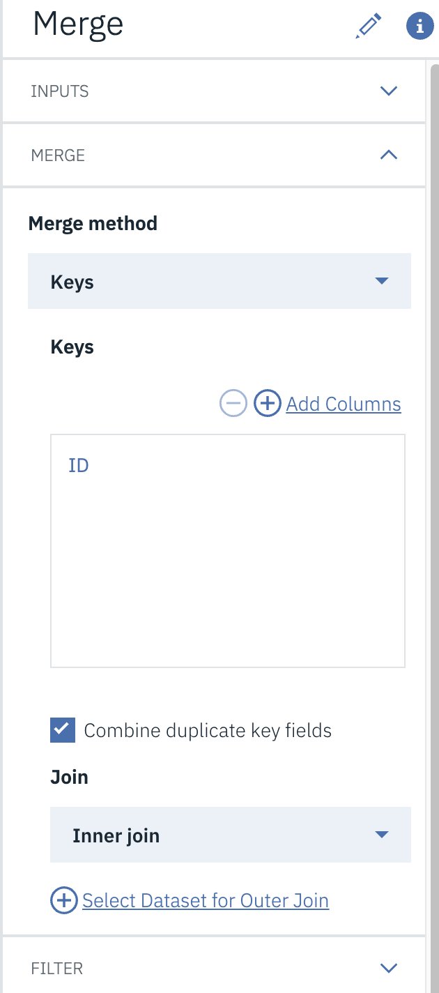
Merge Node to combine data files
Often, different pieces of information for individuals are held in separate locations.
Merge reads multiple input records and creates a single output record, containing some or all of the input fields.
• Include only matching records (inner join). Select to merge only complete records, that is, records that are available in both source files.
• Include matching and non-matching records (full outer join). This means that if a key field(s) value is present in one data source but not present in others, the incomplete records are still retained. The undefined value ($null$) is added to the missing fields and included in the output.
• Include matching and selected non-matching records (partial outer join). This method performs what are called left and right outer joins. All records from the specified file are retained, along with only those records from the other file(s) that match records in the specified file on the key field(s). The Select button allows you to designate which file is to contribute incomplete records. So ifwe wished to retain all records from the customer.dat file and only those from the Append node that matched on ID, then customer.dat would be checked in the Merge: Select Dataset for Outer Join dialog.
Include records in first dataset not matching any others (anti-join). This option provides an easy way of identifying records in a dataset that do not have records with the same key values in any of the other datasets involved in the merge. Thus only records from the dataset that match with no other records will be retained. They might be examined for incorrect key values.

Slide 40
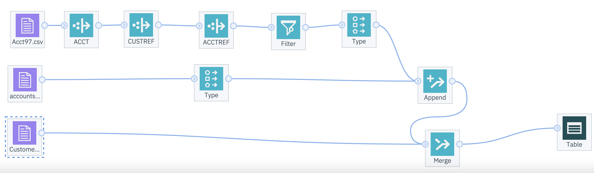
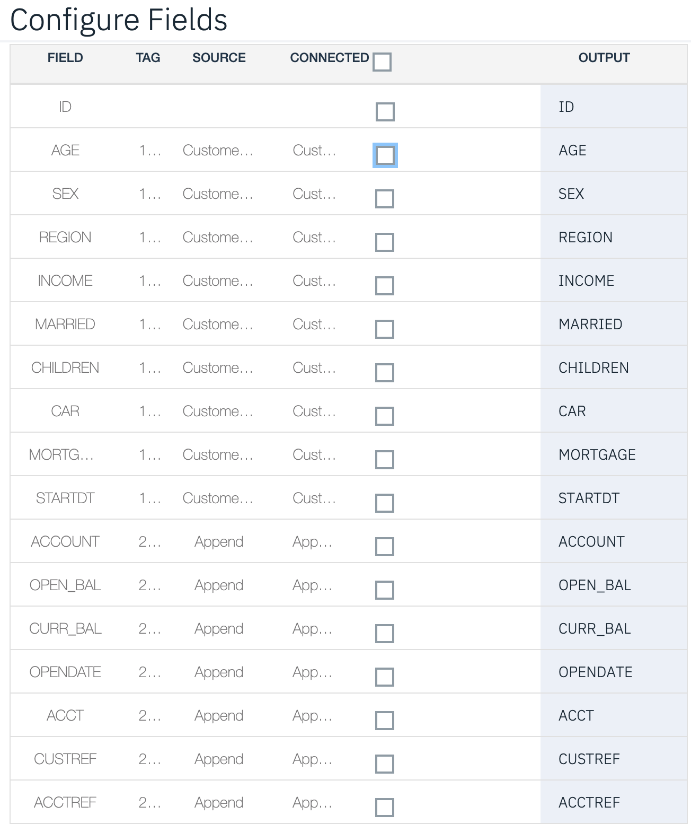
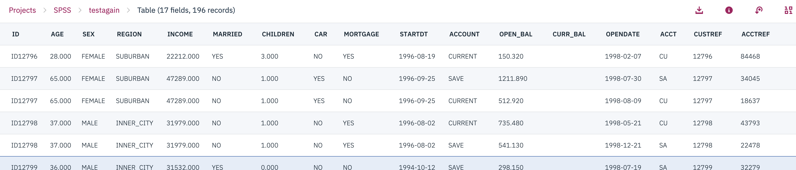

Slide 41
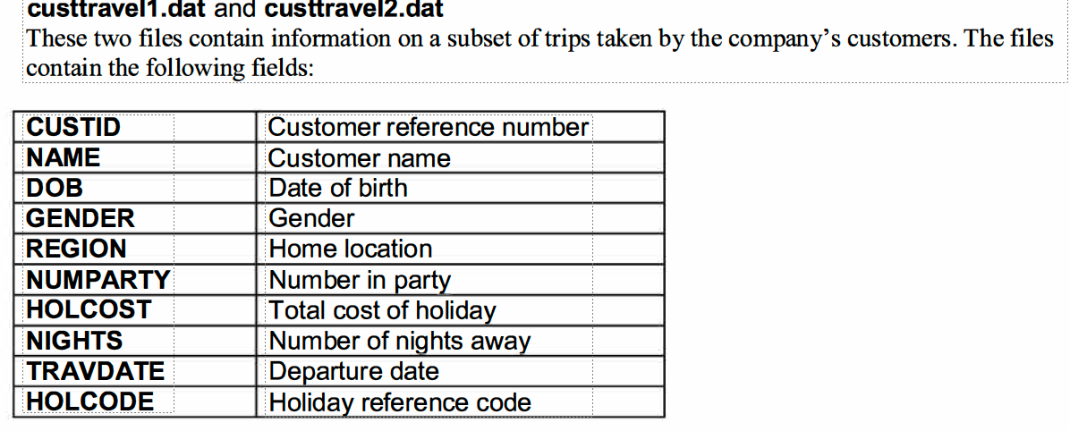
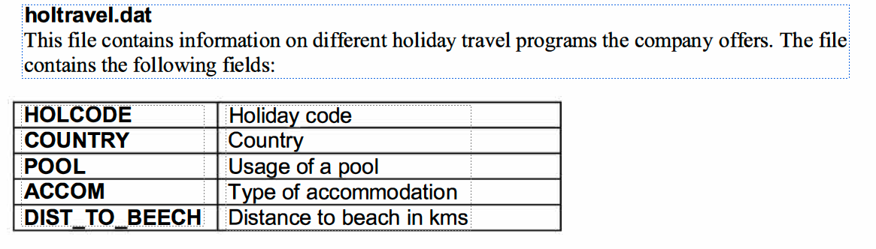
Exercises
We will use data from the travel company that we used previously for the exercises in Lesson 5. In that lesson the data file had already been combined; here our job is to combine separate files to create the merged holidays file.
1. Begin a new stream (File ... New Stream).
2. Select the Var. File node from the Sources palette and place it on the stream canvas. Edit the node and set the file to custtravell.dat held in the c:\Train\Modelerlntro directory. Make sure PASW Modeler reads field names from the first line of the file.
3. Repeat step 2 for the other two files, custtrave/2.dat and holtravel.dat. Both files contain field names.
4. Select three Table nodes from the Output palette and place them next to each of the Var. File nodes. Connect each of the source nodes to a Table node and run each stream. Check each table to ensure that the data files are being read into PASW Modeler correctly.
First join the two customer data files using the Append node.
5. Connect the two customer source nodes to an Append node. Edit the Append node and ensure that custtravell.dat is the first file in the list.
6. Connect a Table node to the Append node and run this section of the stream. Have the two files been successfully joined?
Now merge the holiday information onto the combined customer files.
7. Connect the Append node and the source node labeled holtravel.dat to a Merge node. Edit the Merge node.
8. In the Merge tab, select the keys method of merging. Choose the appropriate field as the merge key. Select the Include matching and non-matching records (full outer join) option.
9. Connect a Table node to the Merge node and run this section of the stream. Have the files been successfully merged?
10. Save the stream as ExerLesson8.str

Slide 42
Aggregating Data
• Introduce the Aggregate node to create summary records
• Introduce the SetToFlag node to transform a categorical field into a collection of flag fields
• Use the Merge node to combine the output from the Aggregate and SetToFlag nodes
• Introduce the Restructure node
Data : Fulldata.txt

Slide 43
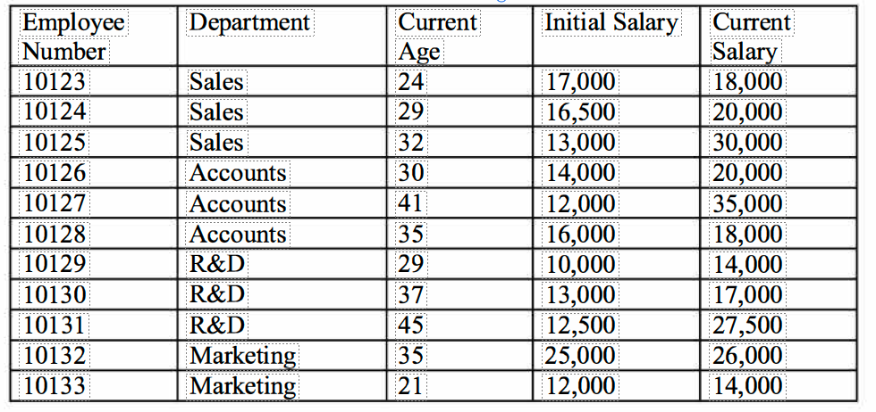

Summarizing Data Using the Aggregate Node
example:
A data file, containing information on individual purchases can be replaced by a file containing summary information on individual customers, such as total amount spent.
A data file in which a record contains end-of-month account balances for different accounts can be replaced by a file with one record per account containing average end-of-month balances for the year.
Information held on individuals, such as age, can be summarized into information representing each household, such as average age
During aggregation at least one key field must be specified. The key field defines the group of records that are to be replaced by one record, and multiple key fields may be used. For example, if summarizing purchase data into customer data, the key field will be a unique customer reference number/ID or a combination of fields that are used to uniquely identify each customer.
Notes:
number of purchases.

Slide 44


Place a Sort node from the Record Ops palette to the right of the Type node Connect the Type node to the Sort node
Edit the Sort node
Select ID in the Sort by: field box
Click OK to return to the Stream Canvas
Place an Aggregate node from the Record Ops palette to the right of the Sort node Connect the Sort node to the Aggregate node
Edit the Aggregate node
If the Keys are contiguous check box is selected, values for the key fields will only be treated as equal if they occur in adjacent records. If the data stream is already sorted in order of the key fields, checking Keys are contiguous will make the aggregation more efficient.

Slide 45
Selecting, Sampling and Partitioning Records
Remove Duplicate records with the Distinct node
Demonstrate the Sort node
Use the Select node for data selection
Demonstrate how to automatically generate a Select node
Sample records randomly with the Sample node
Use the Balance node to increase the number of records in certain categories of a field
Use the Partition node to split the data into separate subsets for the training and testing of models
Use data caching to speed up data processing and freeze sample
Data:
Risk.csv credit risk data : contains information concerning the credit rating and financial position of 4117 individuals, along with basic demographic information, such as marital status and gender.
Fulldata.csv : contains one record per account held by customers of a financial organization. The file contains demographic details on the customer, such as income, gender, and marital status; it also has account information, including account type, opening date, and current balance.
Credit.sav : containing information from a financial institution on its customers.

Slide 46

Remove Duplicate records with the Distinct node
Select the Var. File node and place it on the Stream Canvas
Edit the Var. File node and set the file to fulldata.csv. Click the Preview button
Place a Distinct node from the Record Ops palette to the right of the DataAsset node, and
Edit the Distinct node
Select ID in the Find duplicates in fields field box Make certain the Mode: Include button is selected Click OK to return to the Stream Canvas
Connect the Distinct node to a Table node
Run the Table nod

Slide 47

Selecting Records
select records with the Select node
Assume that we are interested in selecting records for which INCOME is below 20,000 so that we can examine this group more closely.
Method 1 : Select node

Slide 48

Sample Node to Select Records
When mining your data, it is often not necessary to use all of the records stored in a data file.
Data: fulldata.csv
The node has three possible methods of doing simple sampling:
• First: The first n records will be selected (where n is the value in the First text box). The Maximum sample size option is disabled when First and Include sample are selected.
• 1-in-n: every nth record, where n is to be specified in the text box
Random %: a random sample of size r %; the percentage r is to be specified in the text box

Slide 49

Balancing Data
In some situations you may not have a large enough data file to over-sample, but the data may still have too few records in certain categories of the outcome field. As an alternative, the Balance node can be used to make the distribution of a categorical field more equal.
Balancing is carried out by duplicating and/or discarding records based on the conditions you specify.
Note that you are increase the number of records in a category,, but you are not increasing the amount of information

Slide 50

Partition Node
in the Modeling stage of the CRISP-DM process, the data are split into training and testing ( or validation) samples. Models are developed on the training data, and then tested on the testing data sample. The testing and training datasets should be created randomly from the larger total data file for a project, though usually not in equal sizes.
There are several methods available to create these two data files in PASW Modeler:
The Sample node can be used to select two random samples.
The Select node can be used with random functions to effectively select cases randomly.
The Partition node can be used to create a special partition field that can be used directly by modeling nodes.

Slide 51
Exercise
In these exercises, we will use the charity data file.
1. Import data from charity.sav (Statistics File; Read names and labels; Read labels as data).
2. First, we will sort the file on Pre-campaign expenditure (ORISPEND) in descending order. Connect a Sort node to the data source node; and then a Table node to the Sort node. After editing the Sort node, run the Table node. You should note the large number of responders in the first few cases (high expenditures). What other characteristics might you note for those with expenditures of over 500?
3. Connect a Select node to the Sort node. Select all Female Responders. (Hint: use the Expression Builder.) Test the node to verify that it works. Connect a Matrix node and run a matrix table to check your selection. How many records were selected?
4. Connect a Partition node (Field Ops palette) directly to the data source node. Request a 70%training sample and a 30% testing sample. Connect a Means node to the Partition node; use Partition as the group field and request statistics for Pre-campaign Expenditure (ORISPEND). In this manner, you can verify that the two groups have been randomly selected and have similar distributions.
5. For those with extra time: Connect a second Select node (to the data source node) to select Females 50 years of age and older. Run a distribution graph on Response for this group and another for the entire file. How do they compare?

Slide 52
Modeling Techniques in Modeler
PASW Modeler includes a number of machine learning and statistical modeling techniques. Although there are different taxonomies, these techniques can be classified into three main approaches to modeling:
• Predictive
• Clustering
• Association

Slide 53
In predictive modeling, sometimes referred to as supervised learning, inputs are used to predict the values for a target field.
Neural networks, five different rule induction methods, support vector machine, Bayes networks, the self-learning response model, a sequence detection method, regression and logistic regression analysis, discriminant analysis, Cox regression, and generalized linear models. In addition, time series analysis is available using either ARIMA or exponential smoothing.
The different clustering methods, sometimes referred to as unsupervised learning methods, have no concept of a target field. The aim of clustering techniques is to try to segment the data into groups of cases/records that have similar patterns of input fields.
Kohonen networks,
k-means clustering,
two-step clustering.
Association techniques can be thought of as generalized predictive modeling. Here the fields within the data can act as both inputs and target fields. Association rules try to associate a particular conclusion with a set of conditions. There are three association techniques available within P ASW Modeler: Apriori, Carma and Sequence. The Sequence node (mentioned above) will look for association rules over time (i.e., sequences). These could be stages in processing customer service problems, or web pages visited during a visit to a website that led to a product inquiry.

Slide 54
Automated Modeling
The automated modeling methods estimate and compare a number of different modeling methods, allowing you to try out a variety of approaches in a single modeling run.
Auto Classifier
offers several methods to predict a categorical target field ( e.g., did a customer respond to an offer, or not).
Auto Numeric
Analogous to the Auto Classifier, PASW Modeler includes a node to automate the production of models for continuous targets fields. Model types included are Neural Net, C&R Tree, CHAID, Regression, Generalized Linear Models, Support Vector Machines (SVM) and Nearest
Neighbor(KNN). Options can be selected for specific modeling algorithms to try multiple variants. Models are ranked on various criteria, including the correlation of the predicted and actual values of the target, or the relative error in predicting the target.
As with the Auto Classifier, the Auto Numeric node generates output comparing the models you selected. You can then automatically generate model nodes you wish to explore further.
Auto Cluster
The Auto Cluster node estimates and compares clustering models, which identify groups of records that have similar characteristics. The node works in the same manner as other automated modeling nodes, allowing you to experiment with multiple combinations of options in a single modeling pass. Models can be compared using basic measures with which to attempt to filter and rank the usefulness of the cluster models, and provide a measure based on the importance of particular fields.
The Auto Cluster works in the same manner as the Auto Classifier and Auto Numeric nodes, but supports clustering models including TwoStep, K-Means, and Kohonen

Slide 55



Quick Exercise
Data: Risk.CSV
Connect to Type node, filter out ID, Derive SUM DEBT (NUMCARDS + STORECARDS + LOANS), Derive CHILDRE (NUMKIDS > 0)
Place a Partition node from the Field Ops palette to the right of the CHILDREN node Connect the CHILDREN node to the Partition node
Place a Type node from the Field Ops palette to the right of the Partition node Connect the Partition Node to the Type node
Double-click the Partition node to edit it.
6. Place a Table node from the Output palette above the Type node in the Stream Canvas Connect the Type node to the Table node
Run the Table node
7. Click File ... Close to close the Table window Double-click the Type node
8. Click in the cell located in the Role column for Risk (current value is Input) and select Target from the list
8. Click OK
Place the Random Trees node from the Modeling palette to the upper right of the Type node in the
Stream Canvas

Slide 56

Automating Models for Categorical Targets
2. Right-click the Type node attached to the data source node and select Copy Node. Right-click near the GOOD PROFIT node and select Paste
3. Add a Table node . Run the Table node
Data: risk.CSV
1
4. Add an Auto Classifier node from the Modeling palette to the stream to the right of the Type
node
Attach the Type node to the Auto Classifier node
Edit the Auto Classifier node
2. Edit the node labeled GOOD PROFIT
(The Derive type is Flag. The value of GOOD PROFIT will be T when the value of RISK is good risk, else it will be false. This simple operation will create the new field with only two values)

Slide 57
More Exercise

Slide 58
Lab Session – Working with an SPSS Visual Model
Go to “My Projects → YourProject → Assets” and select New Flow next to Modeler Flows
Select the New option from the top of the form
Enter a Name (Churn_<Initials>) & Description
Select IBM SPSS Modeler
Select Create at bottom of the screen
Select the icon and Drag & drop Customer.csv & Churn.csv data sources to the canvas
* Alternatively, select Import and drag a Data Asset element to the canvas
* Right click on each of the data sources and click on Change data asset and select the Customer.csv
* Rename the data asset to Customer and save your changes
* Repeat these steps for the Churn.csv file
Right click on each of the data sources and select Preview to view data
Under Record Operations, select & drag the Merge node to the canvas
Connect the Customer (Connect 1st) & Churn data sources to the Merge node
Right click the Merge node and select Open->Settings
Choose Keys for the Merge Method
Select Add Columns and choose ID from the list
Select Combine Duplicate Key Fields
Select Inner Join for Join field
Select Save at the bottom of the screen

Slide 59

Data audit
The Data Audit node provides a comprehensive first look at the data
Summary statistics, histograms, and distribution graphs that may be useful in gaining a preliminary understanding of the data.
Information about outliers, extremes, and missing values.

Slide 60


Lab Session – Working with an SPSS Visual Model - continued
Under Graph, select & drag the Distribution node to the canvas and connect to the Merge node.
Right click and select Open to edit.
Under Plot select Churn for Field selection
Select Gender for Color selection
Select Save and right click to Run the flow. View results (Churn) under “Outputs” on the right of the screen
Double-click on the Outputs to see results

Slide 61


Lab Session – Building the Model to Predict Churn
Under Field Operation, select & drag the Type node to the canvas and connect it to the Merge node
Right click on the Type node and select Open
Select Read metadata and click on Read Values
Change Role of Churn field to Target
Change Measure of Churn field to Flag
Select Save
Under Modeling, select & drag the C5 node (popular decision tree Algorithm) to the canvas
Connect Type to the C5 node
Right click on the C5 node and select Run. Your model should look like this:

Slide 62

Lab Session – Building the Model to Predict Churn Cont.
After the model has run, Right click on the model nugget (Yellow) and select View Model
Explore the model and review predictors via the Top Decision Rules
Navigate back to the model view
Under Outputs select Table from and drag it to the canvas
Under Exports select Data Export and drag it to the canvas
Connect Table & Data Export to the nugget
Right click on the Object Store (Data Export icon) and choose Open
Enter ScoringOutput_<Initials>.csv for the “Target path”
Select Save
Run the entire stream by selecting the “Run” icon
This process scores the data and creates the output. Your model should look like this:
Right Click on the Table object and select Preview
Scroll to the right to review the $C-Churn predictor value and the $CC-CHURN confidence value associated with the prediction

Slide 63

Lab Session – Evaluating & Saving the Model
Now that the model has been built, we can evaluate the model with a different data set
Use the New_Customer_Churn.csv file for evaluation
Delete the connection going to the model nugget (via Right-click)
Add the New_Customer_Churn.csv file to the canvas and connect it to the model nugget
Under Outputs, select & drag the Analysis node to the canvas and connect it to the model nugget
Right click on the Analysis node and select Save branch as a model
Enter a Model Name (i.e. ChurnSPSS_<initials>) & select Save
This process saves your model to the Machine Learning library
Right click on the Analysis node and select Run
The results are in the Outputs tab. Your model should look like this:
Review the Analysis output & Table output to view the results
The model to predict Customer Churn has been completed and tested. This model can now be deployed for batch or real time scoring. Once deployed, the model can be integrated with Line of Business applications.

